Slide 1
Perceptron 1957
Neural Networks
Deep Learning
Artificial Intelligence 1950
Machine learning
DeepMind
2010
ImageNet Challenge 2012
Google
2014
TensorFlow 2015
OpenAI
2015 Elon Musk
AlphaGo 2016
AlphaZero 2017
Twitter
2021
Transformer 2018
Microsoft
2019
Bard
2023
chat GPT
2018~
x.AI
2023

Slide 2
Year | LLM | Model size | Training data
2011 | Recursive Neural Tensor Network (RNTN) | 1.6M | Wikipedia and news articles
2012 | Recursive Deep Semantic Model (RDSM) | 100M parameters | Wikipedia and news articles
2013 | Attentive Neural Network Language Model (ANLM) | 1.2B parameters | Wikipedia and news articles
2014 | Bidirectional Language Model (BiLM) | 312M parameters | BooksCorpus and English Wikipedia
2017 | Transformer | 117M parameters | BooksCorpus and English Wikipedia
2018 | BERT | 340M parameters | BooksCorpus and English Wikipedia
2019 | GPT-2 | 1.5B parameters | BooksCorpus and English Wikipedia
2020 | GPT-3 | 175B parameters | BooksCorpus and English Wikipedia
2022 | ChatGPT 3.5 | 1.37B | 1.64TB of data, including programming codes, academic papers, and news articles

Slide 3
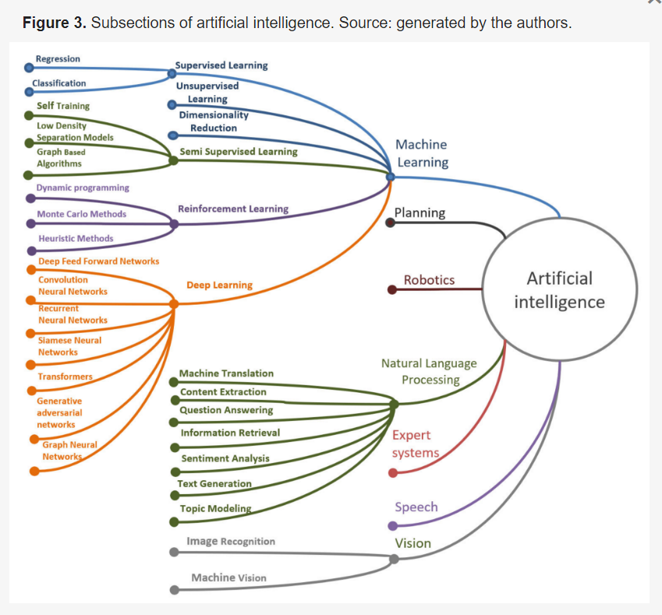
Transformer

Slide 4
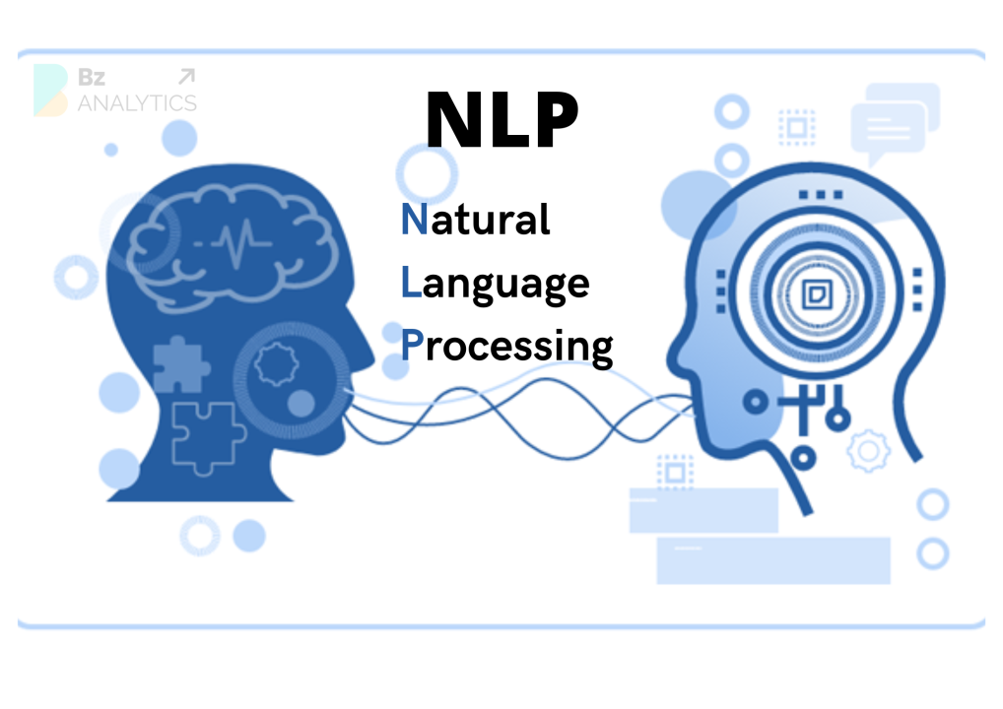

Slide 5
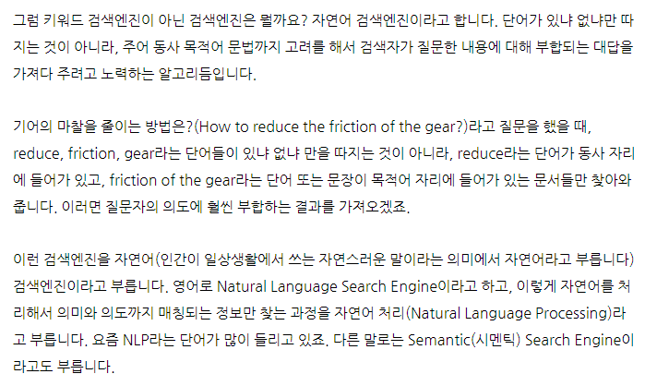
https://contents.premium.naver.com/chatgpt/buff/contents/230622235641423mo

Slide 6
Conventional Search Engine:
Relies on keyword matching and indexing.
Results are based on factors like keyword density and page rankings.
Provides a list of relevant web pages.
Emphasizes popularity and authority of web pages.
Does not focus on understanding the meaning or context of the search query.
Semantic Search Engine:
Analyzes the meaning and context of the search query.
Considers user's location, search history, and other factors.
Provides more personalized and context-aware results.
Understands relationships between words and concepts.
Uses natural language processing (NLP) techniques.
Presents rich snippets and leverages knowledge graphs for additional context.
Aims to deliver more accurate and meaningful search results.
In summary, conventional search engines primarily rely on keyword matching, while semantic search engines aim to understand the meaning and intent behind search queries, providing more contextually relevant results.

Slide 7
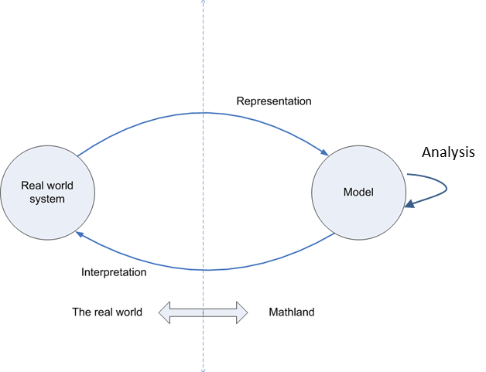
Diagram of Model use and Development

Slide 8
Term | Definition
Model | A mathematical representation of a system or process. A model can be used to predict the behavior of a system or to understand how a system works.
Language model | A statistical model that predicts the probability of a sequence of words. Language models are used in a variety of natural language processing tasks, such as speech recognition, machine translation, and text summarization.
Large language model (LLM) | A language model that has been trained on a massive dataset of text. LLMs have billions of parameters, which allows them to learn complex patterns in language. LLMs are used for a variety of tasks, such as question answering, summarization, and creative text generation.

Slide 9
Type | Parameters | Training Data | Tasks
Probabilistic language model | Millions | Books, articles, code, etc. | Speech recognition, machine translation, text summarization
Neural language model | Billions | Books, articles, code, etc. | Question answering, summarization, creative text generation
Large language model (LLM) | Trillions | Books, articles, code, web documents, etc. | All of the above, plus more complex tasks such as code generation and translation

Slide 10
LLM Functionality
Classification Response Generation Text Generation Translation Knowledge Answering

Slide 11
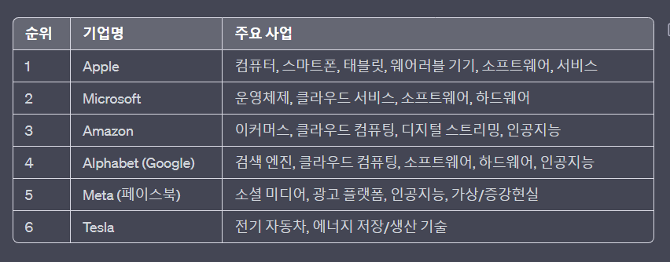
미국 시가총액 상위 6대 기업 중 애플을 제외하고 모두 LLM을 개발

Slide 12
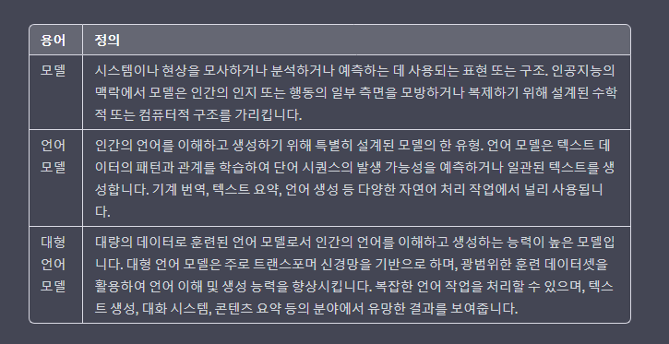

Slide 13
Language Model
As a form of generative AI, large language models can be used to
not only assess existing text
but to generate original content based on user inputs and queries.

Slide 14
A large language model (LLM) chatbot developed by Google AI. Bard is trained on a massive dataset of text and code, and can generate text, translate languages, write different kinds of creative content, and answer your questions in an informative way.
Year | Event
1943 | Warren McCulloch and Walter Pitts propose the perceptron.
1958 | Frank Rosenblatt builds the first perceptron machine.
1969 | Marvin Minsky and Seymour Papert publish "Perceptrons", which criticizes the perceptron's limitations.
1986 | Geoffrey Hinton, David Rumelhart, and Ronald Williams introduce backpropagation, a way to train neural networks with multiple layers.
1989 | Yann LeCun et al. train a neural network to recognize handwritten digits.
1998 | The ImageNet dataset is released, which allows for the training of larger and more complex neural networks.
2012 | Alex Krizhevsky et al. introduce AlexNet, a convolutional neural network that achieves state-of-the-art results on the ImageNet dataset.
2015 | Google DeepMind introduces AlphaGo, a neural network that defeats a professional Go player.
2017 | OpenAI introduces GPT-1, a large language model that can generate realistic and coherent text.
2020 | OpenAI introduces GPT-3, a larger and more powerful language model.
2022 | Google AI introduces PaLM, the largest language model in the world.

Slide 15
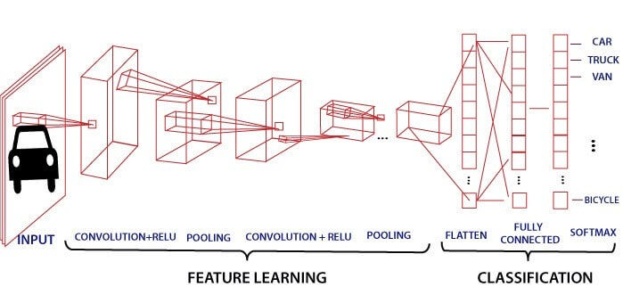
Alex Krizhevsky et al. introduce AlexNet, a convolutional neural network that achieves state-of-the-art results on the ImageNet dataset. 2012

Slide 16
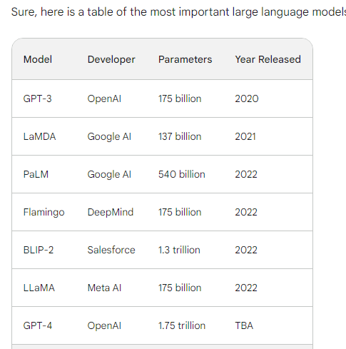
Year | Event
2021 | Bard is first announced by Google AI.
2022 | Bard is released in beta to a small group of users.
2023 | Bard is released to the public in early 2023.
Current | Bard is still under development, but it is learning new things every day.
GPT-3: GPT-3 is a large language model developed by OpenAI. It is one of the most widely used large language models, and it is known for its ability to generate realistic and coherent text.
LaMDA: LaMDA is a large language model developed by Google AI. It is known for its ability to answer questions in an informative way, even if they are open ended, challenging, or strange.
PaLM: PaLM is a large language model developed by Google AI. It is the largest language model in the world, and it is known for its ability to perform a wide range of tasks, including translation, summarization, and code generation.
Flamingo: Flamingo is a large language model developed by DeepMind. It is known for its ability to generate creative text formats, such as poems, code, scripts, musical pieces, email, letters, etc.
BLIP-2: BLIP-2 is a large language model developed by Salesforce. It is known for its ability to understand and respond to natural language queries.
LLaMA: LLaMA is a large language model developed by Meta AI. It is known for its ability to learn from human feedback and improve its performance over time.
GPT-4: GPT-4 is the next generation of GPT-3, and it is expected to be even more powerful and capable.

Slide 17
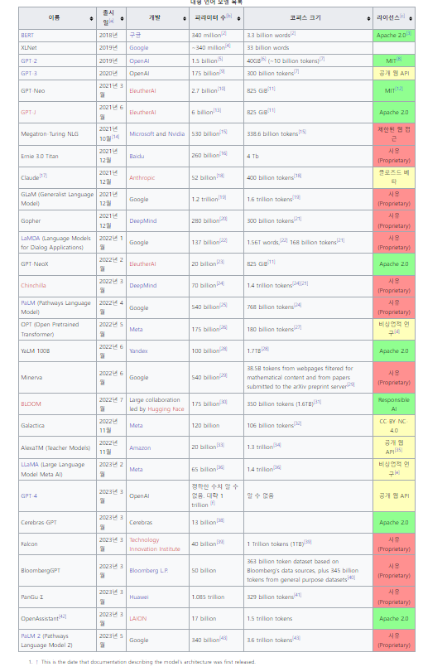
Large Language Model
수많은 파라미터(보통 수십억 웨이트 이상)를 보유한 인공 신경망으로 구성되는 언어 모델이다.
자기 지도 학습이나 반자기지도학습을 사용하여 레이블링되지 않은 상당한 양의 텍스트로 훈련된다.^{[1]}
LLM은 2018년 즈음에 모습을 드러냈으며 다양한 작업을 위해 수행된다.
이전의 특정 작업의 특수한 지도 학습 모델의 훈련 패러다임에서 벗어나 자연어 처리 연구로 초점이 옮겨졌다.

Slide 18
Language models
Language models are trained using a technique called "deep learning” which involves training a large neural network on massive datasets.
How many words trained by chat GPT?
ChatGPT, based on the GPT-3.5 architecture, was trained on a vast amount of data containing 570GB of text. However, it's important to note that the number of words in the training data is not explicitly specified by OpenAI.

Slide 19
Model
Sure. In artificial intelligence (AI),
a model is a mathematical representation of a real-world system.
Models are used to make predictions about the behavior of the system, and they can also be used to control the system.
There are many different types of models in AI, including:
Statistical models are based on statistical data, and they are used to make predictions about future events. For example, a statistical model could be used to predict the weather or the stock market.
Neural networks are inspired by the human brain, and they are used to learn complex relationships between data. For example, a neural network could be used to recognize objects in images or to translate languages.
Rule-based models are based on a set of rules, and they are used to make decisions based on those rules. For example, a rule-based model could be used to determine whether a loan application should be approved or denied.
Models are used in a wide variety of AI applications, including:
Machine learning
Natural language processing
Computer vision
Robotics
Game playing

Slide 20
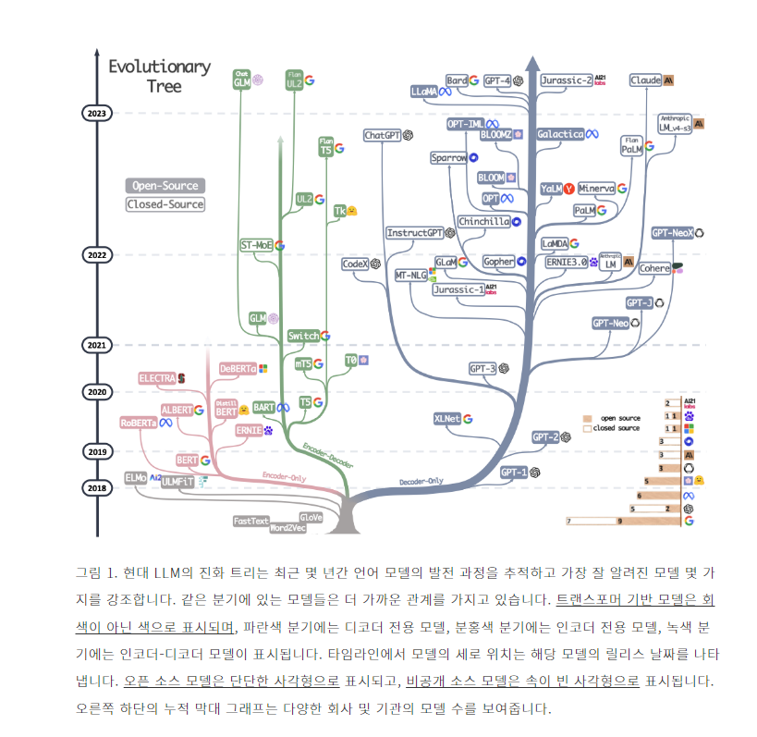
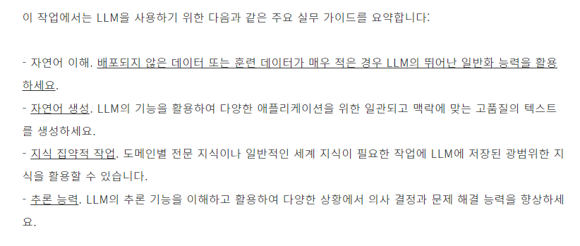

Slide 21
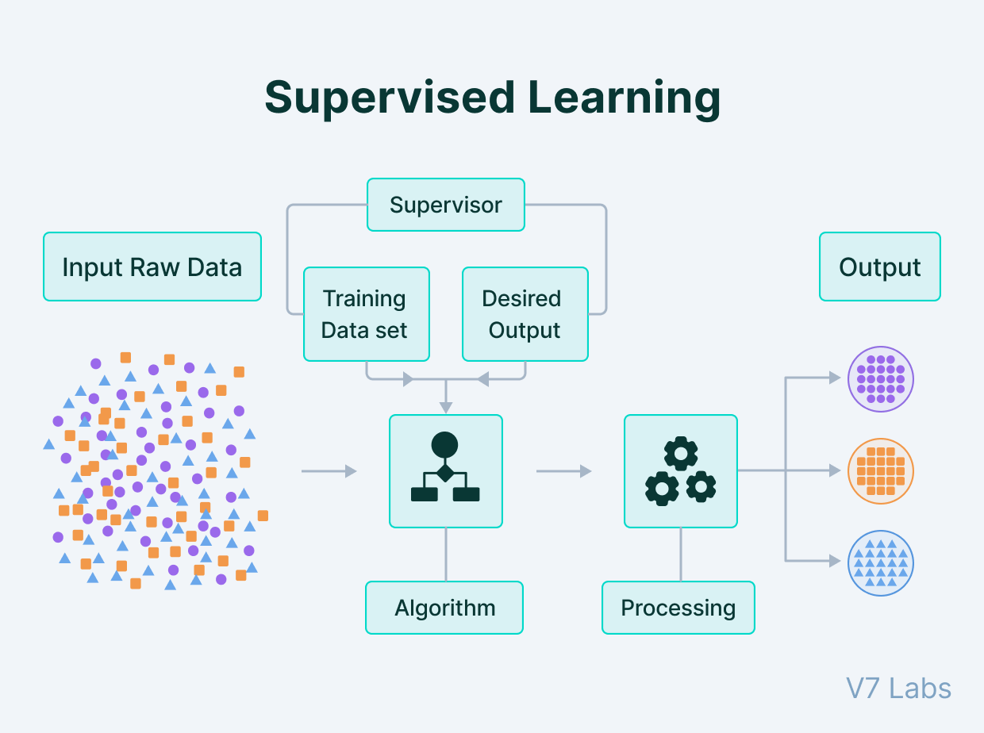

Slide 22
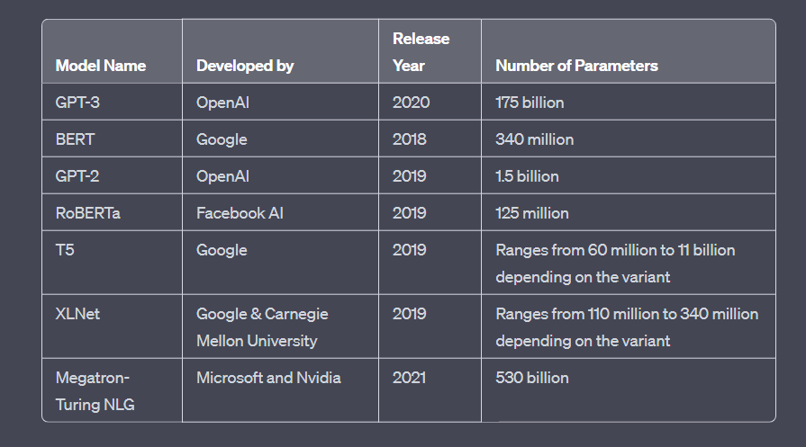
large language models

Slide 23
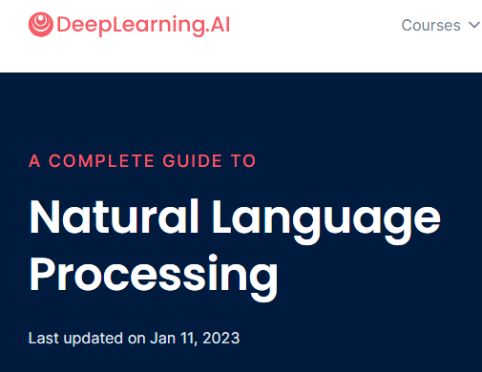
Natural Language Processing
Natural Language Processing (NLP) [A Complete Guide] (deeplearning.ai)

